Slide 1
PHY 101 by Dr O. E. Abe & J. C. EHIABHILI
Course Content
Space and Time
frame of reference
Invariance of physical law
relativity of simultaneity
Galilean Invariancee
Universal Gravitational

Slide 2
Space and Time
In Physics or physical sciences, space is referred to the three-dimensional coordinates points. In other word, it is an arrangement of all possible point locations where logical statement(s) can be derived to solve a specific problem
Time is one-dimensional quantity that is independent of space. It could be regarded as an origin from which to take duration past or future to any other time instant.

Slide 3
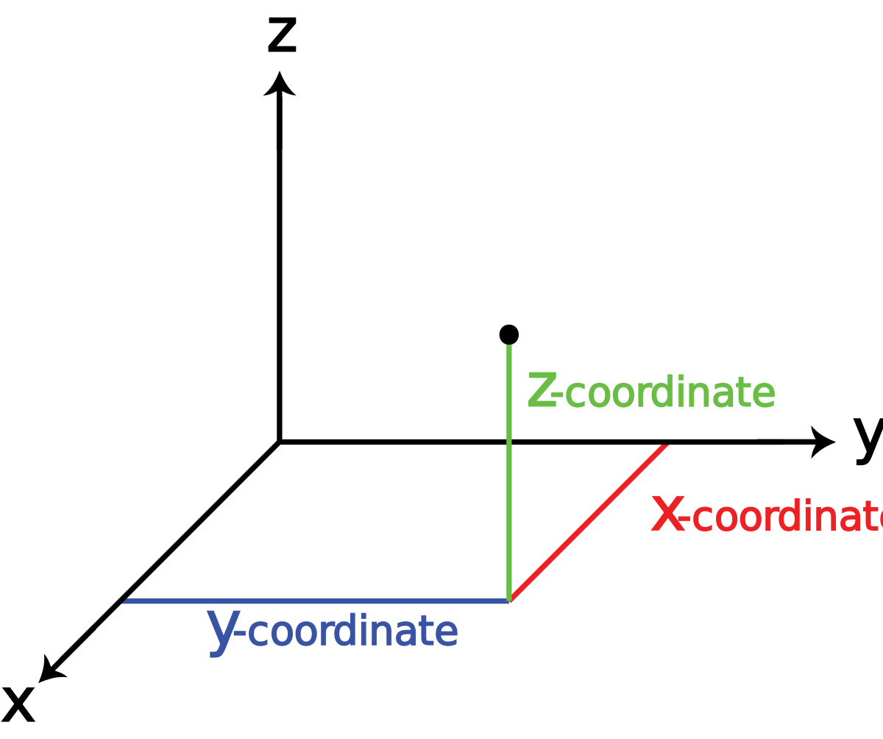
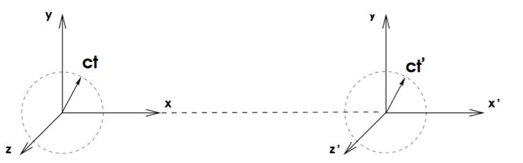
In classical mechanics, time is separated from space,
however, in special relativity; time and space are fused together making four-dimensional geometry called space-time

Slide 4
The principle of relativity
The principles of relativity are described into two postulates.
The speed of light in vacuum is always the same; and
It is not possible to measure the absolute speed of an object but only relative can be measured.
The second postulate needs some explanation in the sense that the earth is moving in a rotational motion about its axis round the sun with a known speed, and all the object therein are moving relatively to the earth’s speed and invariably to the sun.

Slide 5
We can only state how fast one object is moving relative to another.
The second postulate can be expressed as the basic laws of nature,
which are in all reference fames moving with constant velocity relative to each other
are the same in all inertial frame of reference.

Slide 6
A reference frame is any coordinate system relative to which measurements are taken. For example, the position of a bed, chair, and table can be described to the walls of a room. The room is then the reference frame. In another way, if a fly is sitting on a window in a moving car. The window of the car can describe the position of the fly on the car.
An inertia reference frame is a coordinate system in which the law of inertia applies: a body remains at rest unless an unbalance force on it causes it to be accelerated. All reference systems moving with constant velocity relative to distant stars are inertia frames.

Slide 7
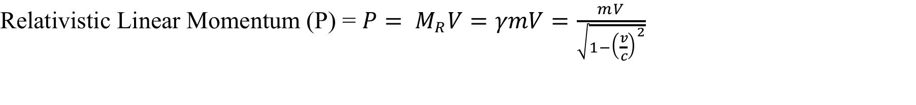
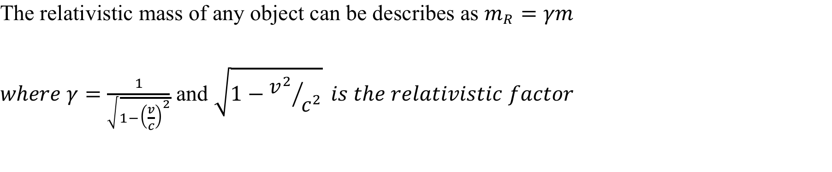
The above postulates can be summarised as follow.
Apparently, if you are in motion relative to two points that are fixed distance apart, the distance between the two points appears shorter than if you were at rest relative to them. The ratio of the two points is the relativistic factor.

Slide 8
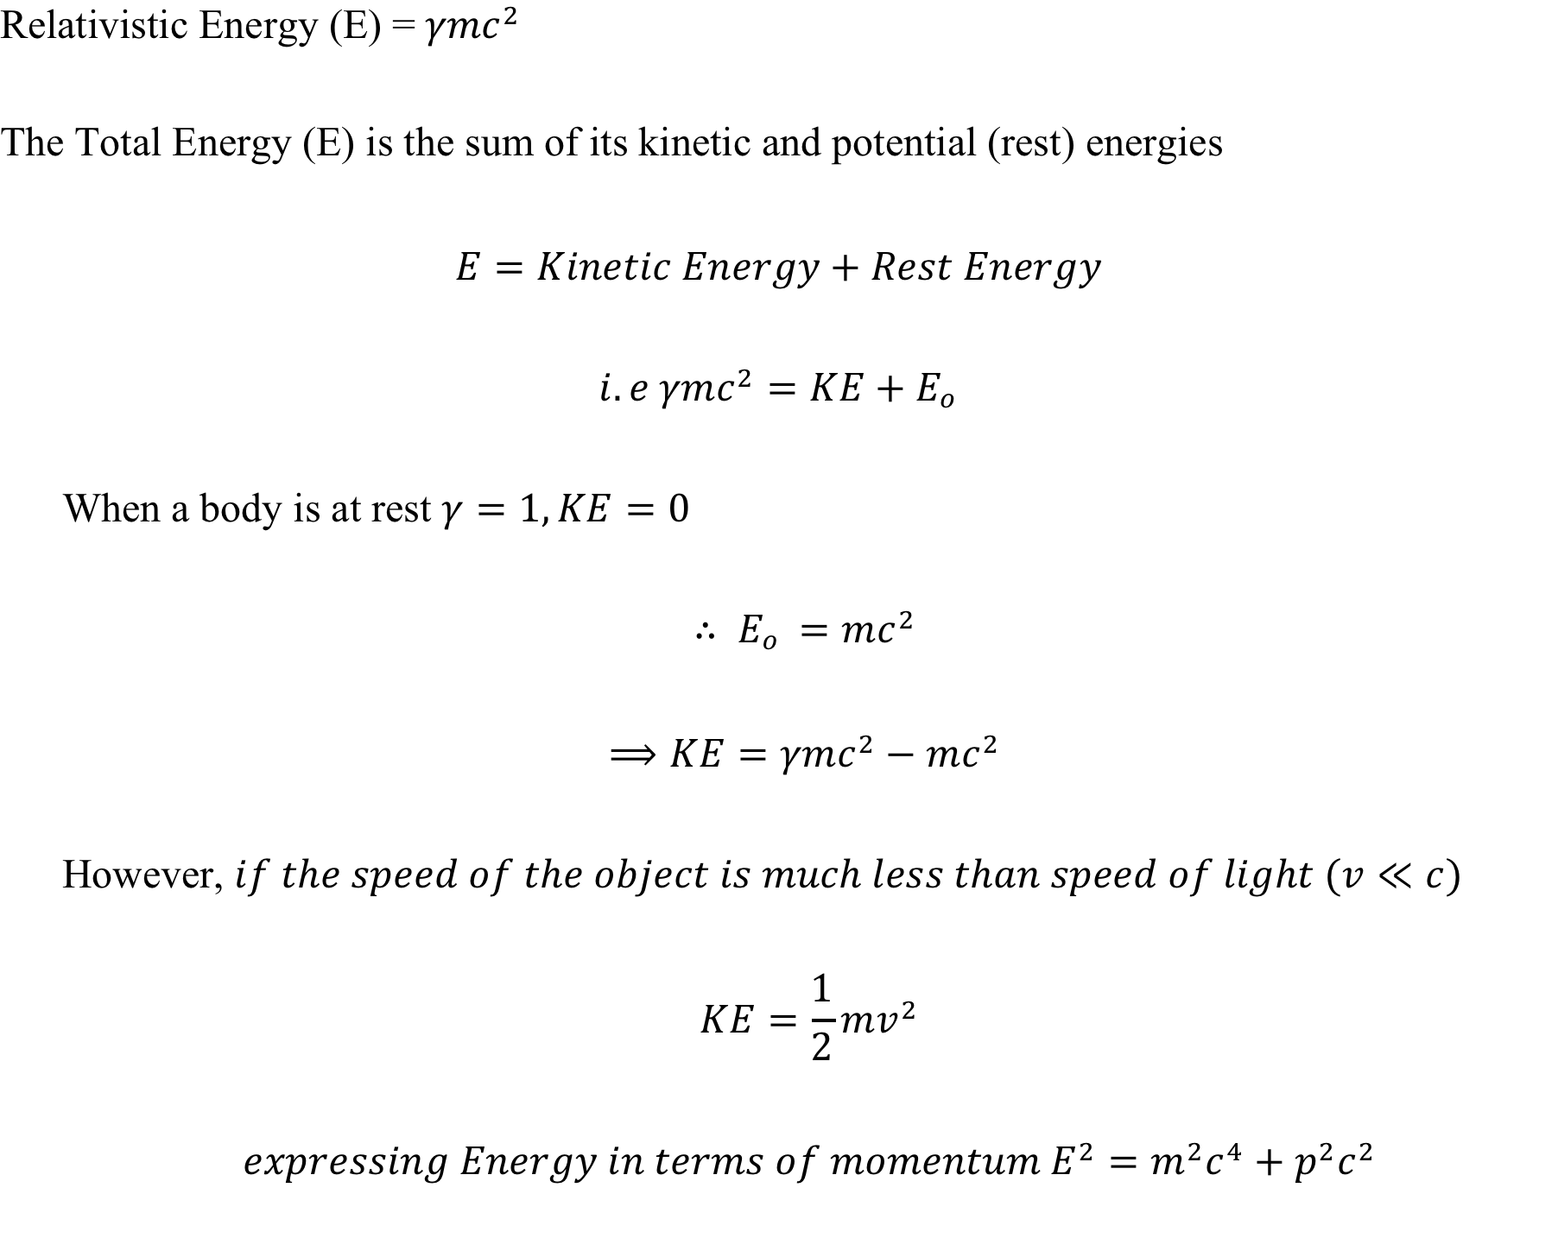

Slide 9
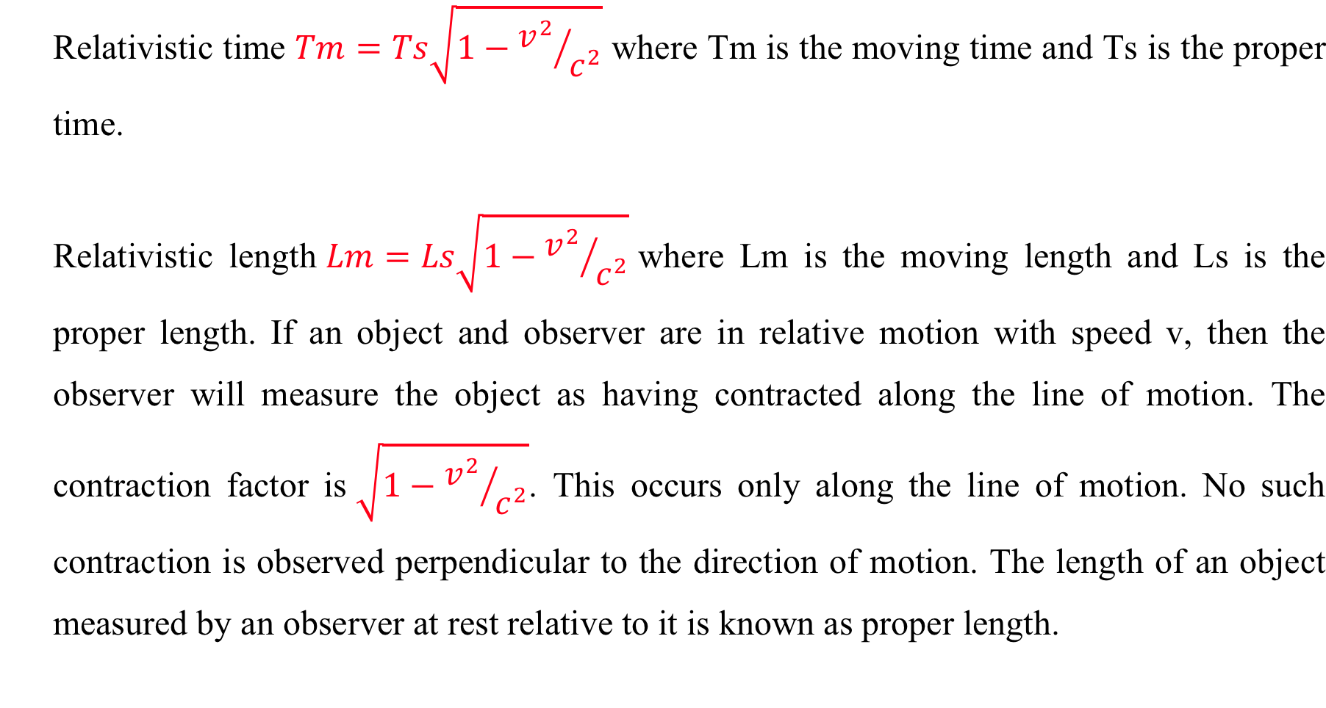

Slide 10
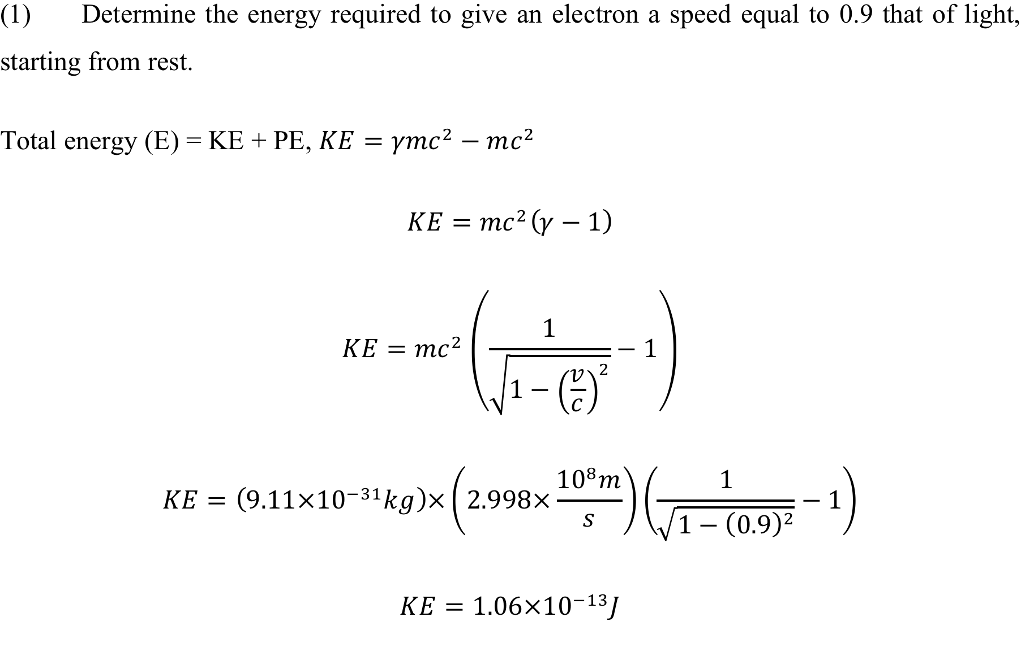
Worked Example

Slide 11
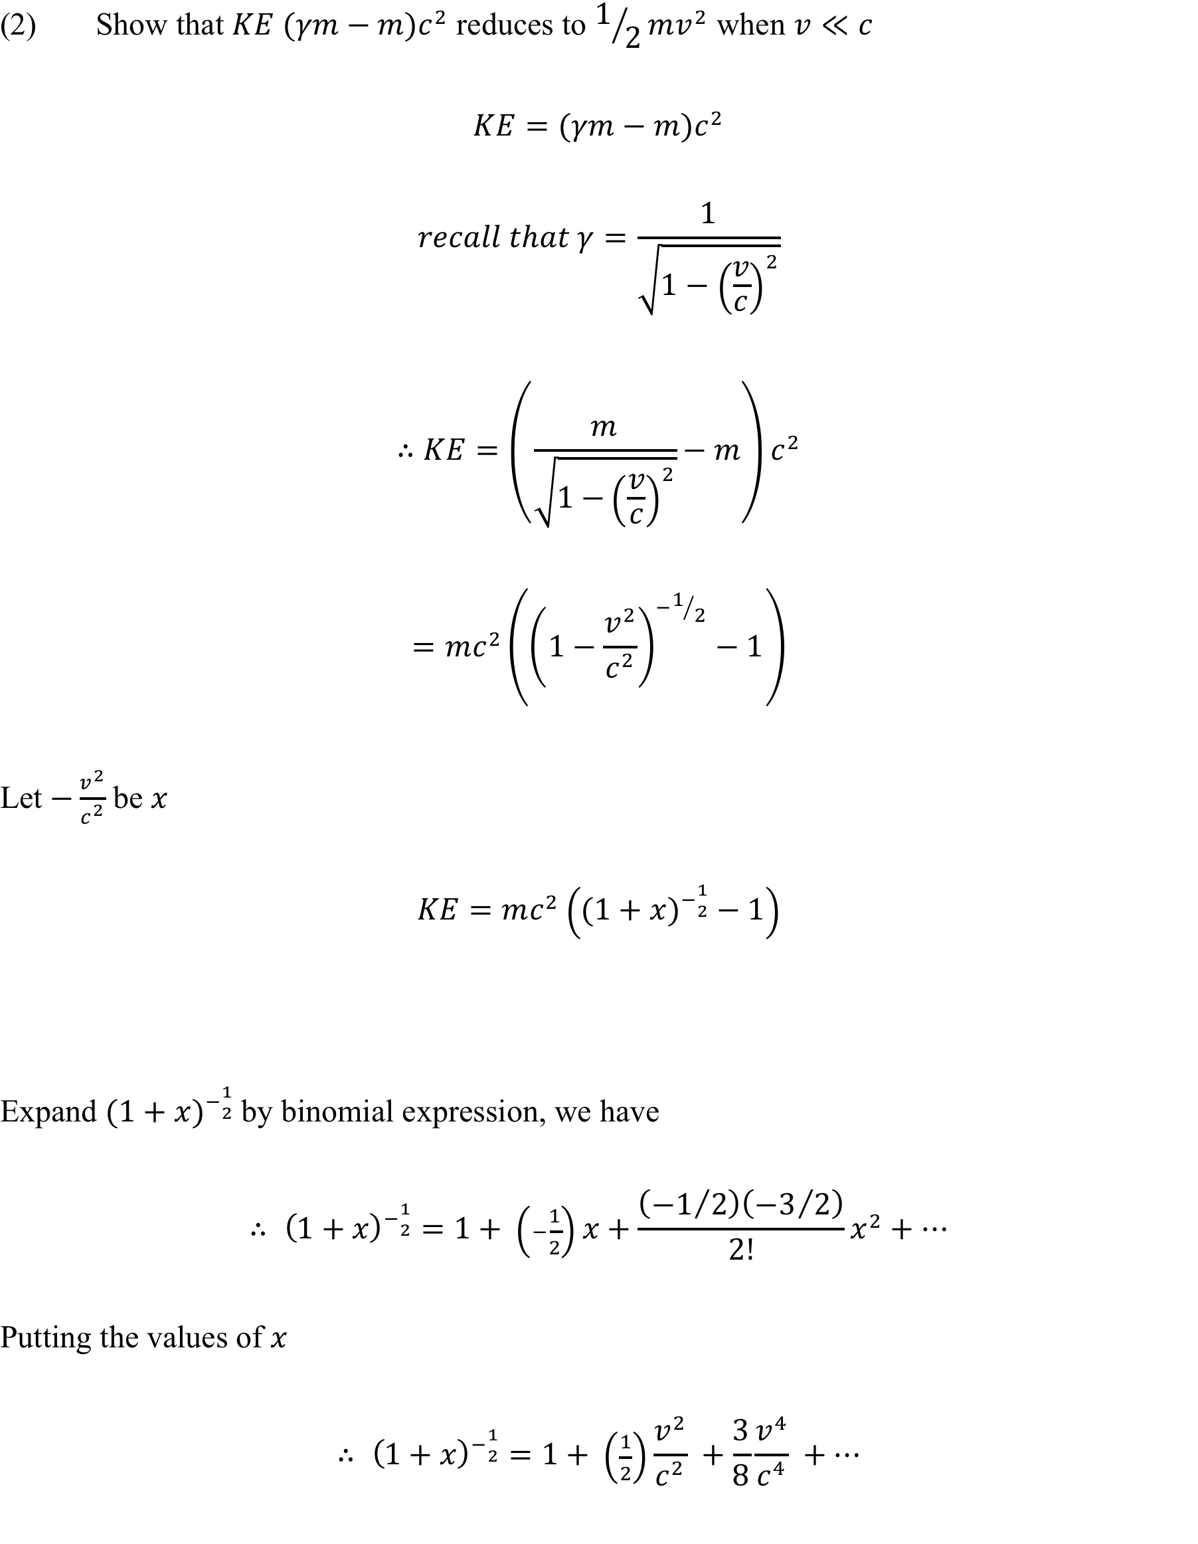

Slide 12
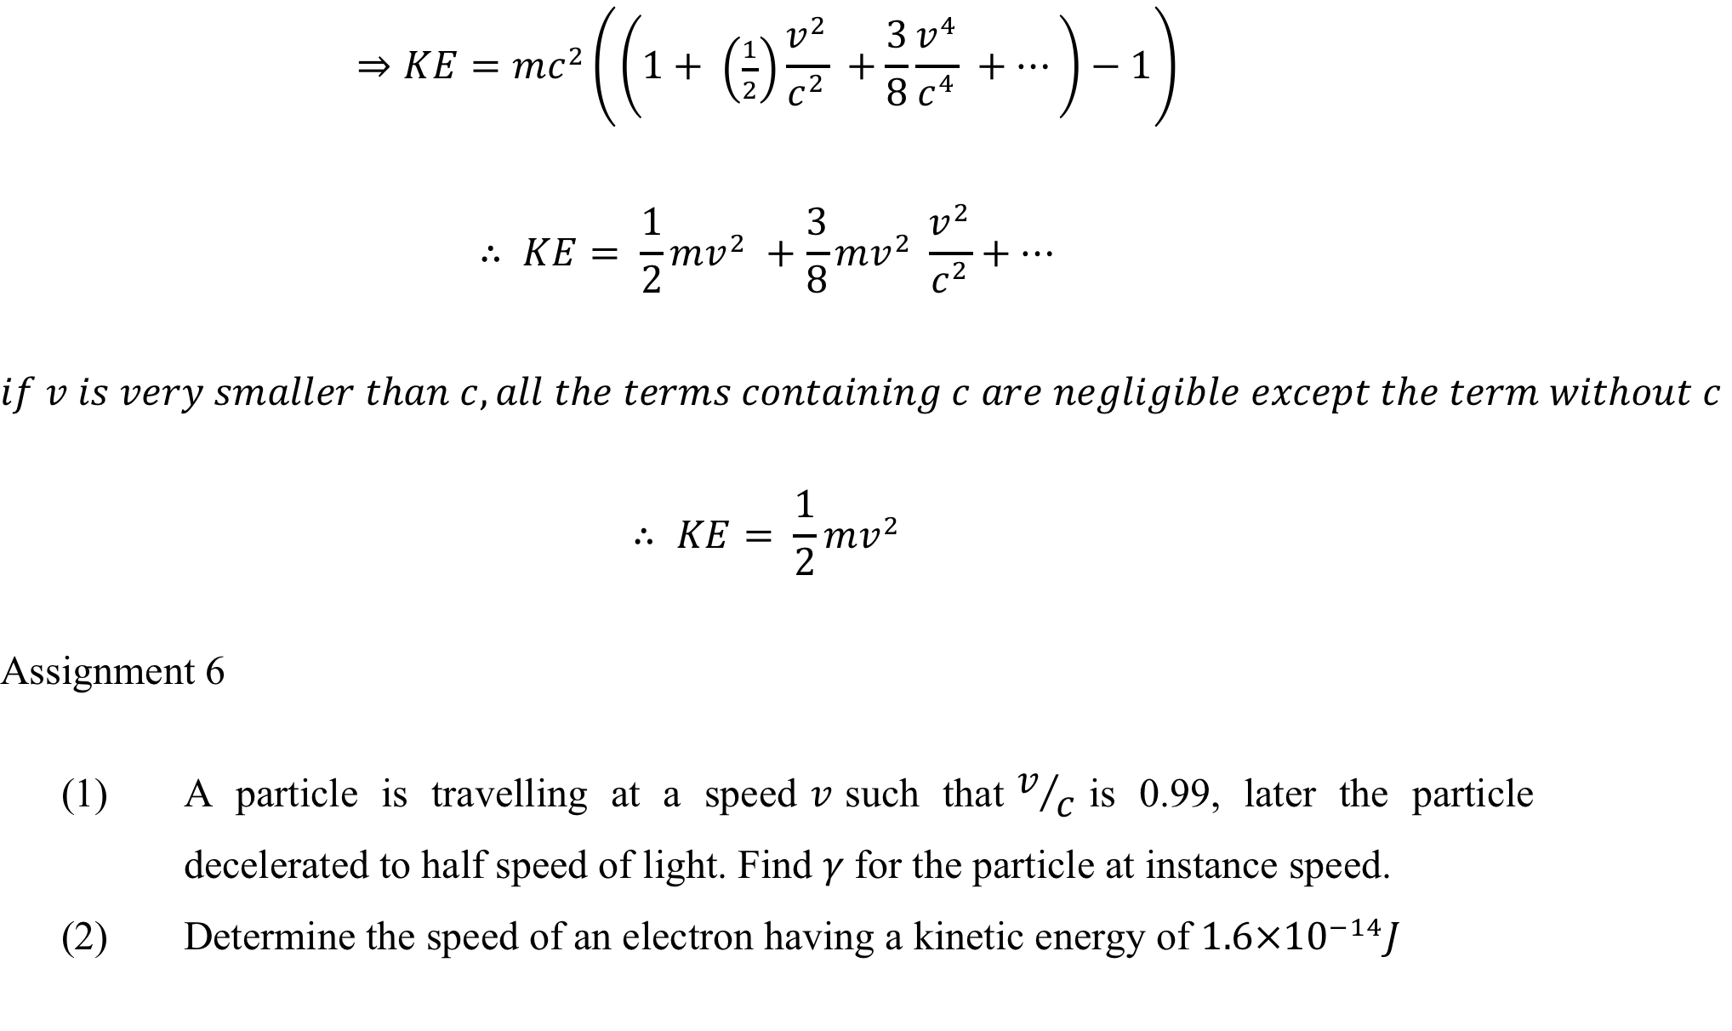

Slide 13
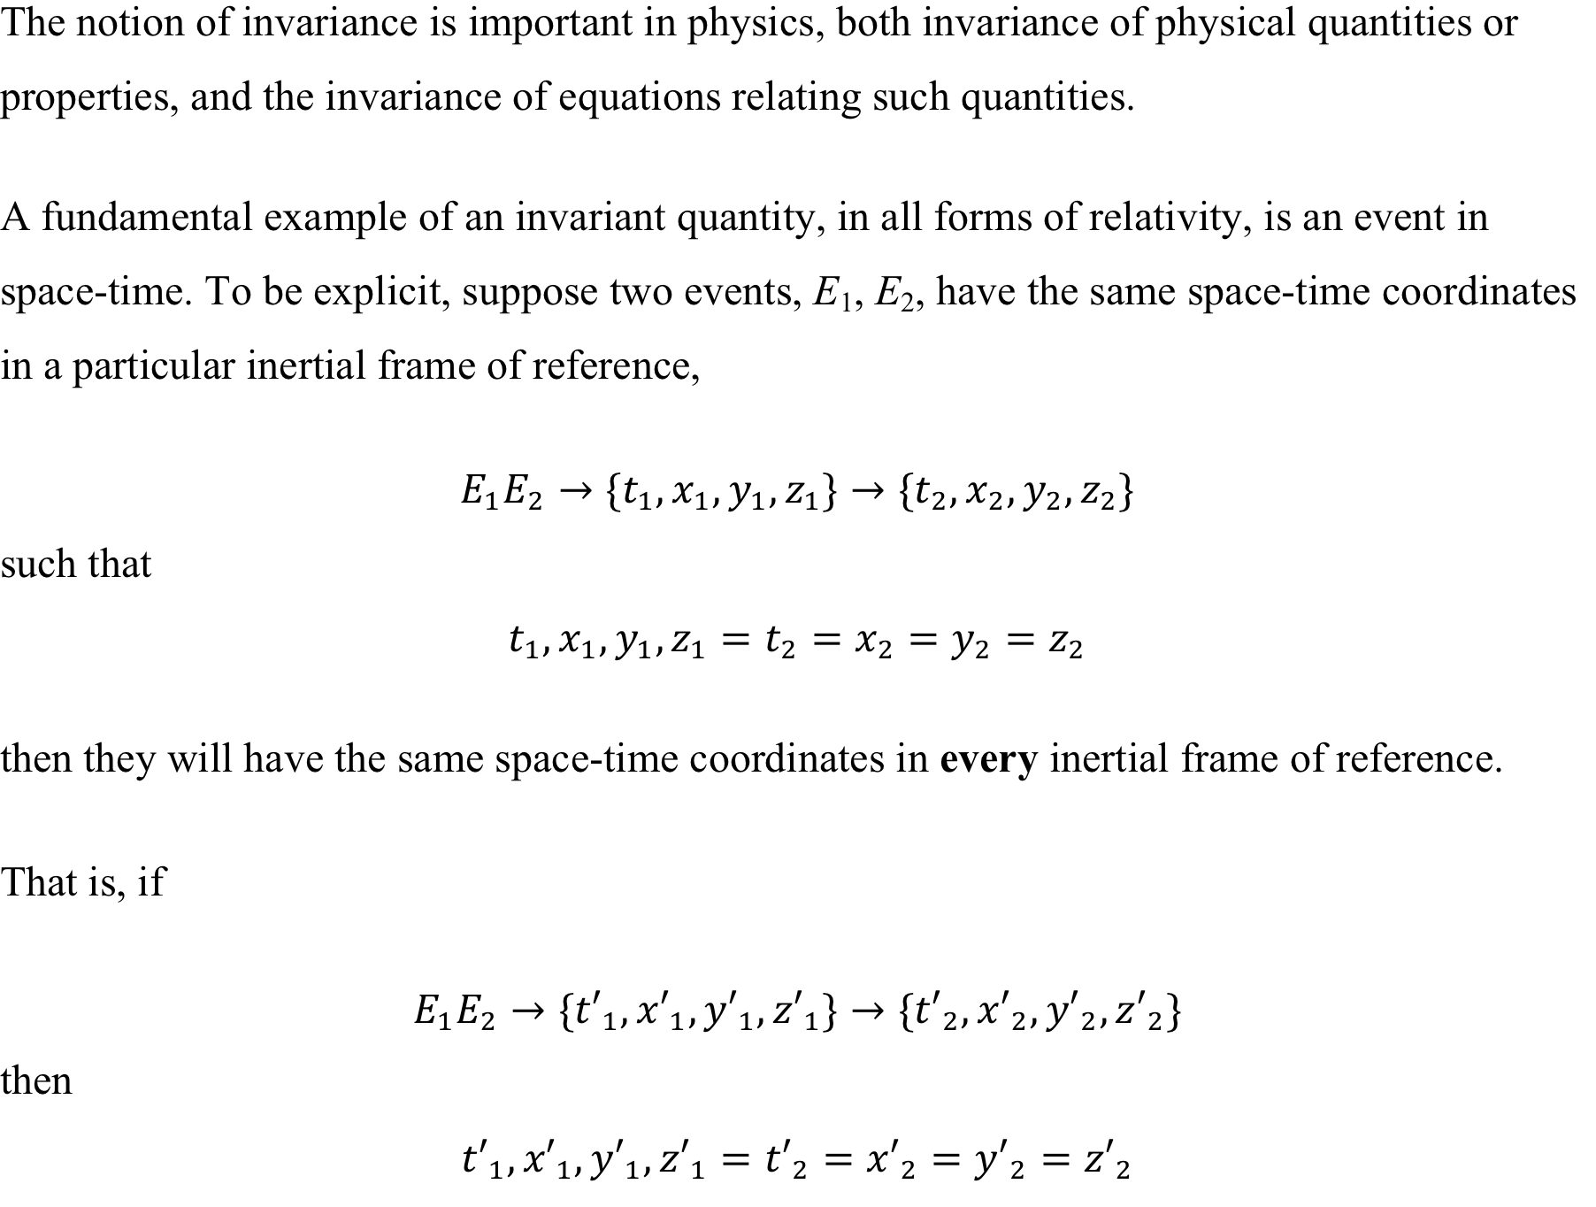
Invariance of physical law

Slide 14
Simultaneity
In Galilean relativity, time is invariant, and so we can consider simultaneous events, which are events that occur at the same time, but not necessarily at the same location. Then, if two events are simultaneous in one frame, they will be simultaneous in any other frame.
This, along with time-invariance itself, gets dropped in special relativity.
Spatial separation
Following directly from the invariance of simultaneity, consider the spatial separation between two simultaneous events - the two ends of a meter stick moving at speed v.

Slide 15
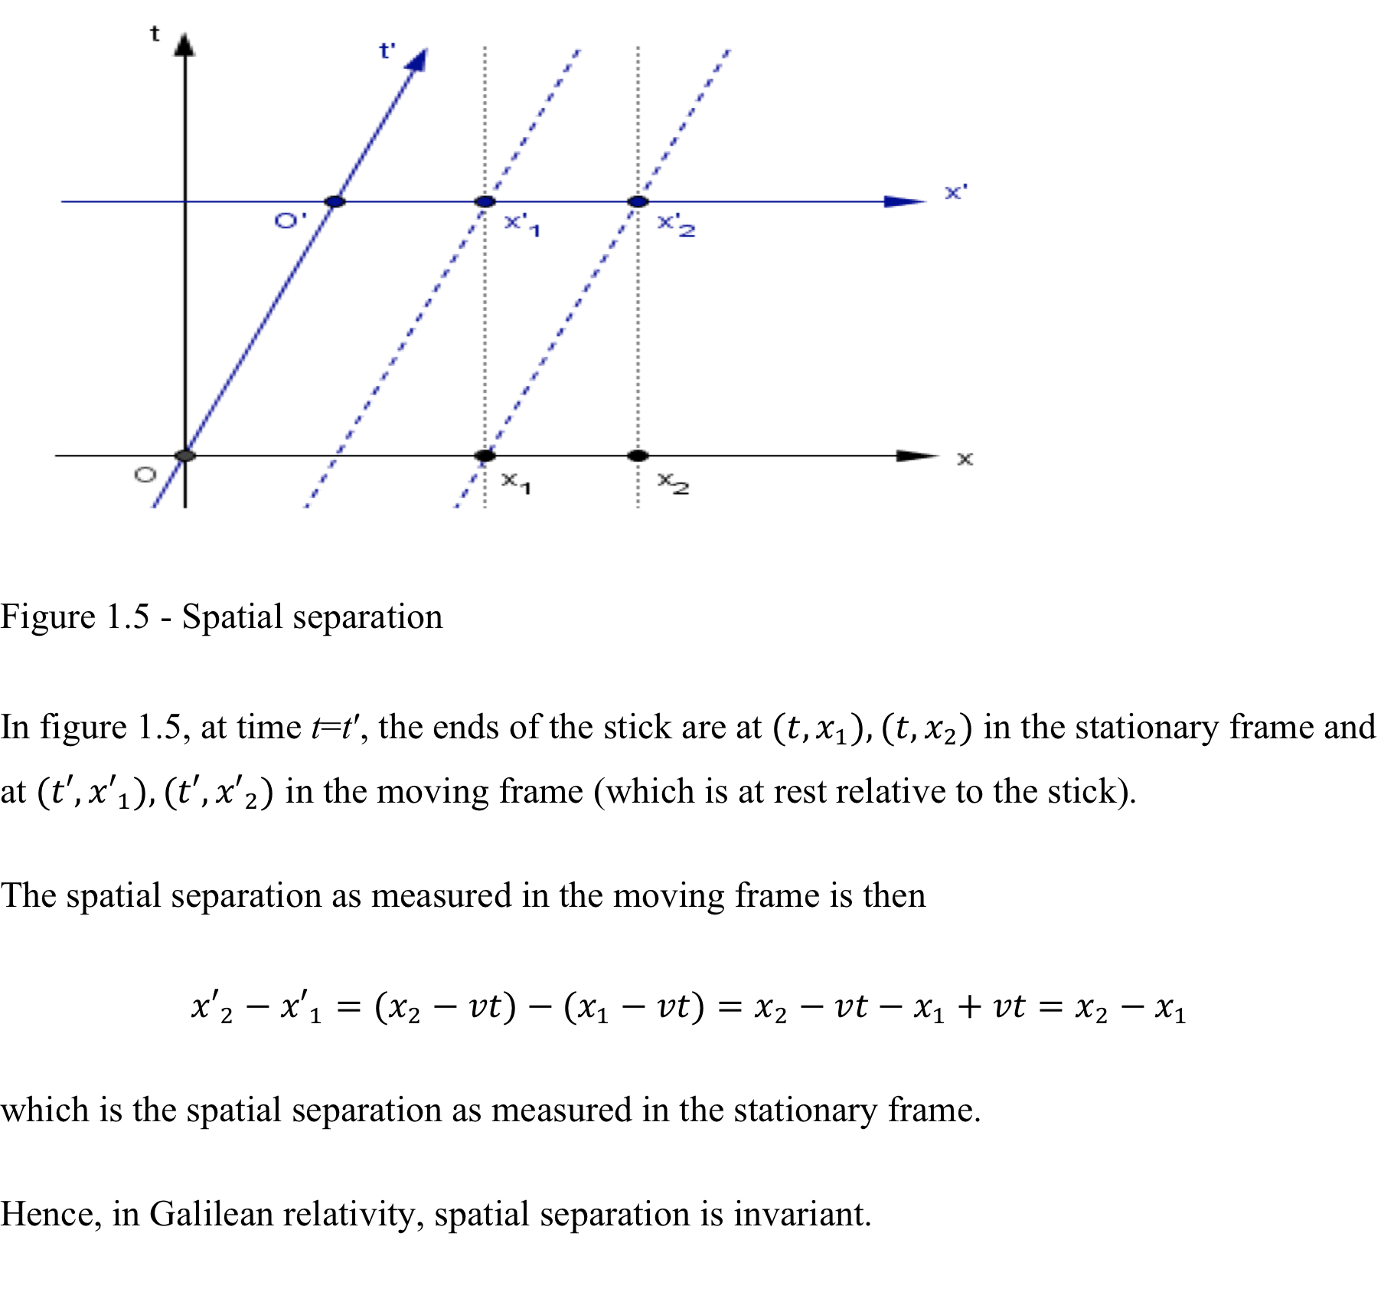

Slide 16
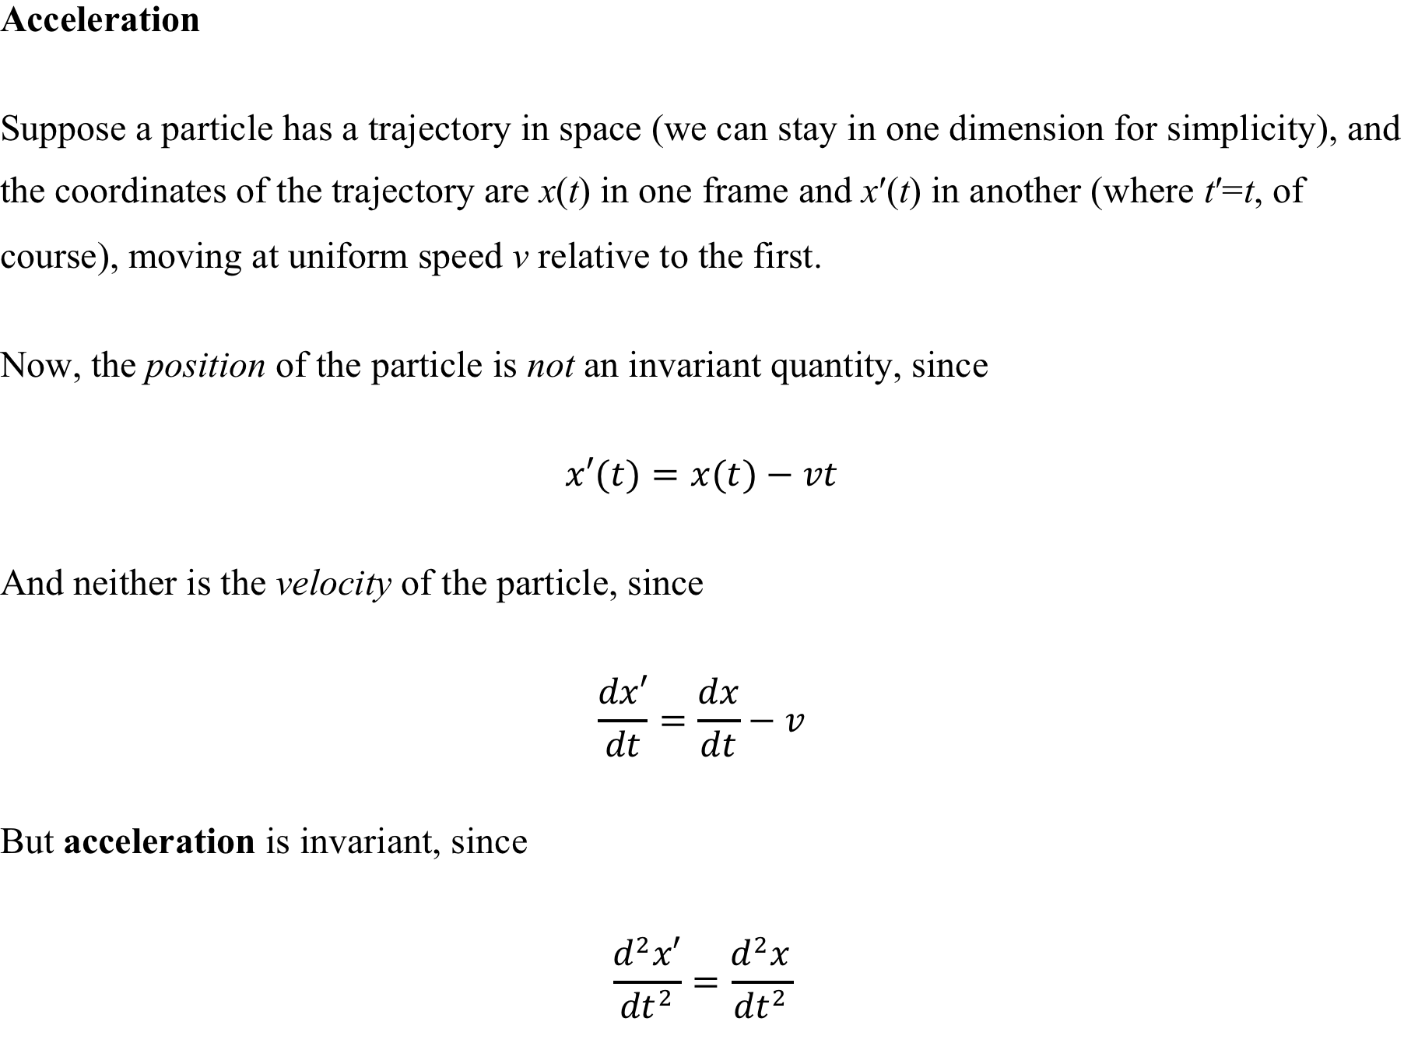

Slide 17
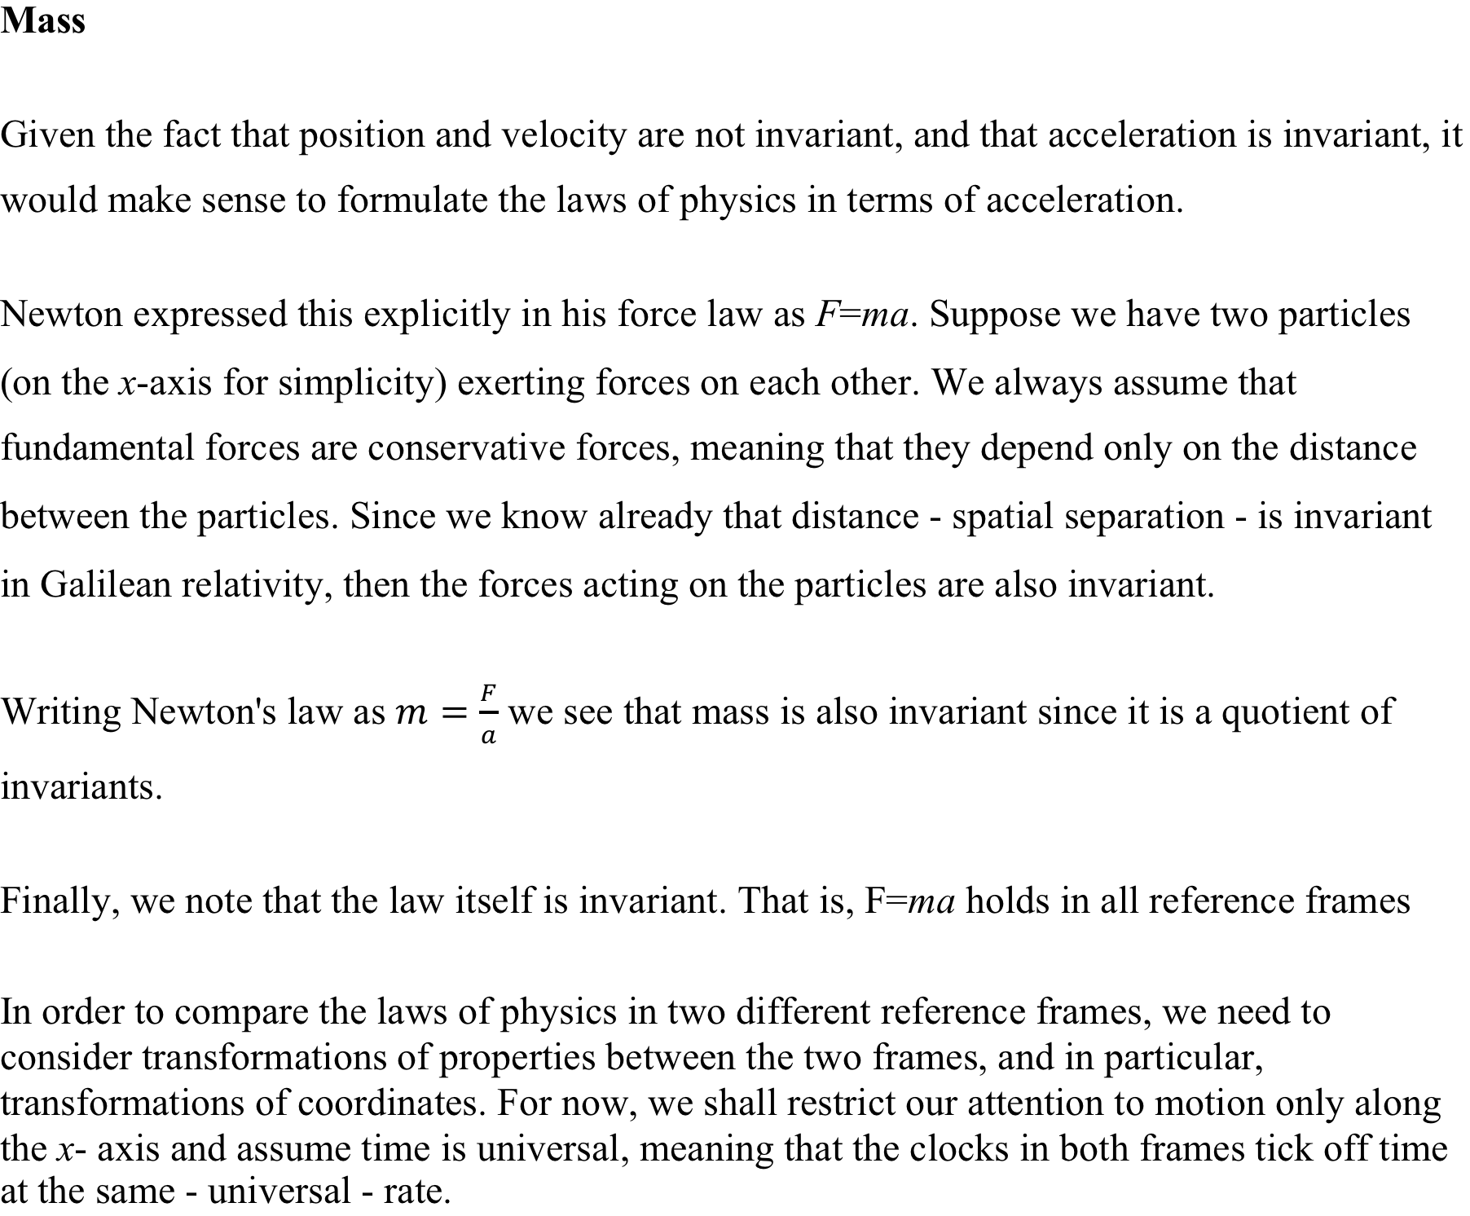

Slide 18
GALILEAN INVARIANCE
Galilean invariance or Galilean relativity states that the laws of motion are the same in all inertial frames of reference.
It is a reference frame in relative motion to absolute space. In such a frame, the object does not accelerate.
Galilee Galileo first described this principle using the example of a ship travelling at constant velocity, without rocking, on a smooth sea; any observer performing experiments below the deck would not be able to tell whether the ship was moving or stationary.
Among the axioms from Newton’s theory are:
There exists an absolute space in which Newton’s laws are true.
All inertial frames share a universal time.

Slide 19
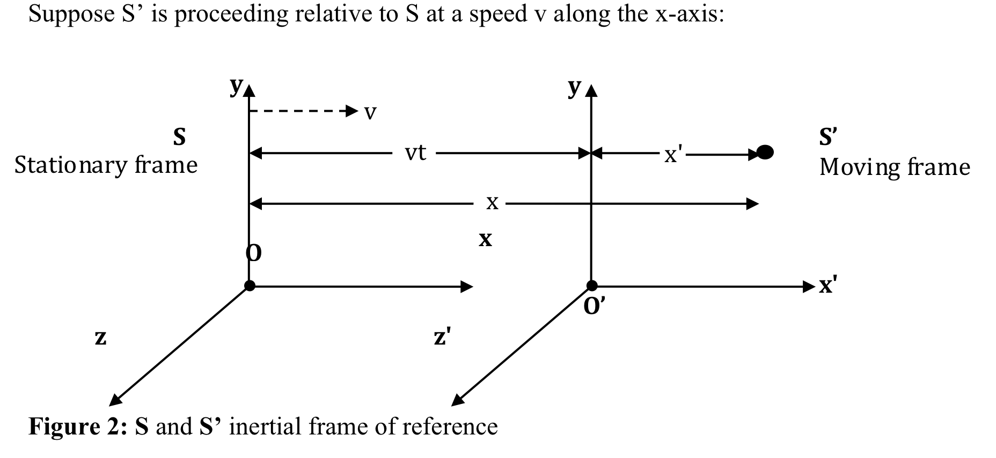
Galilean Transformation Equations

Slide 20
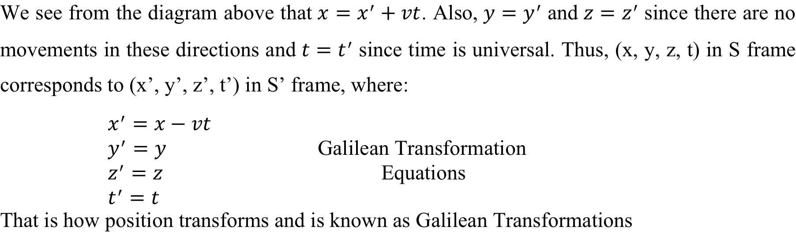
Galilean Transformation Equations

Slide 21
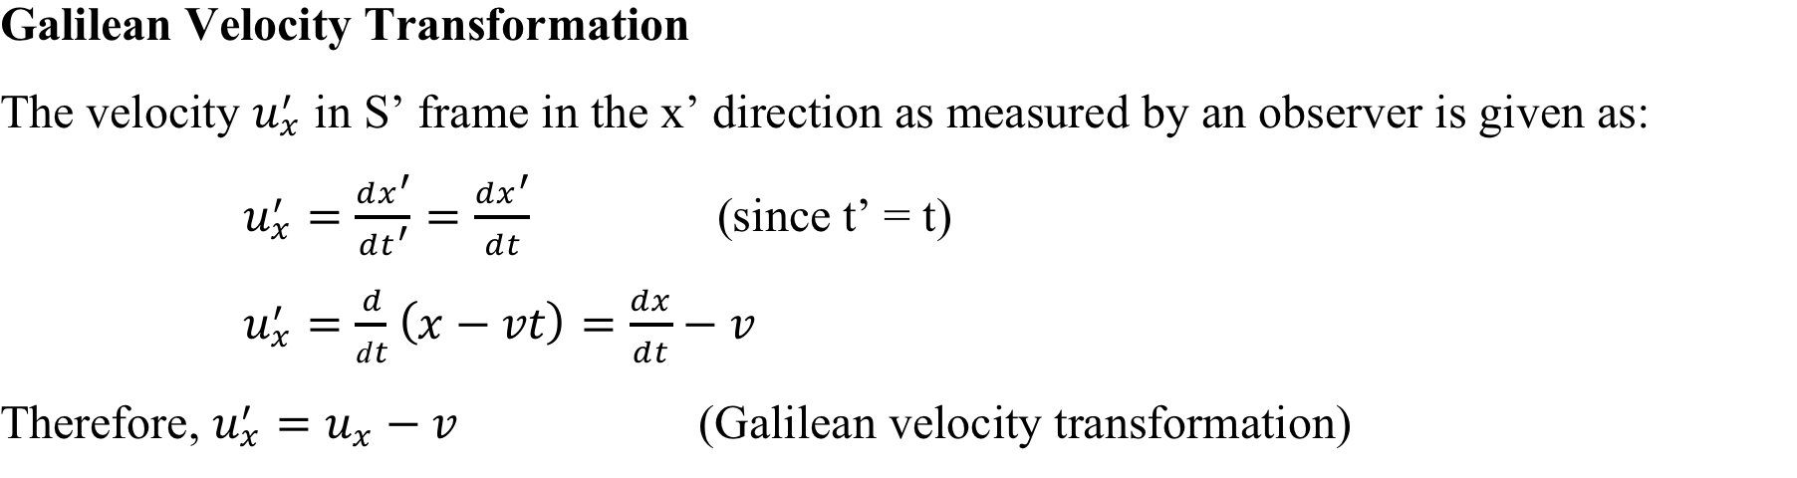

Slide 22
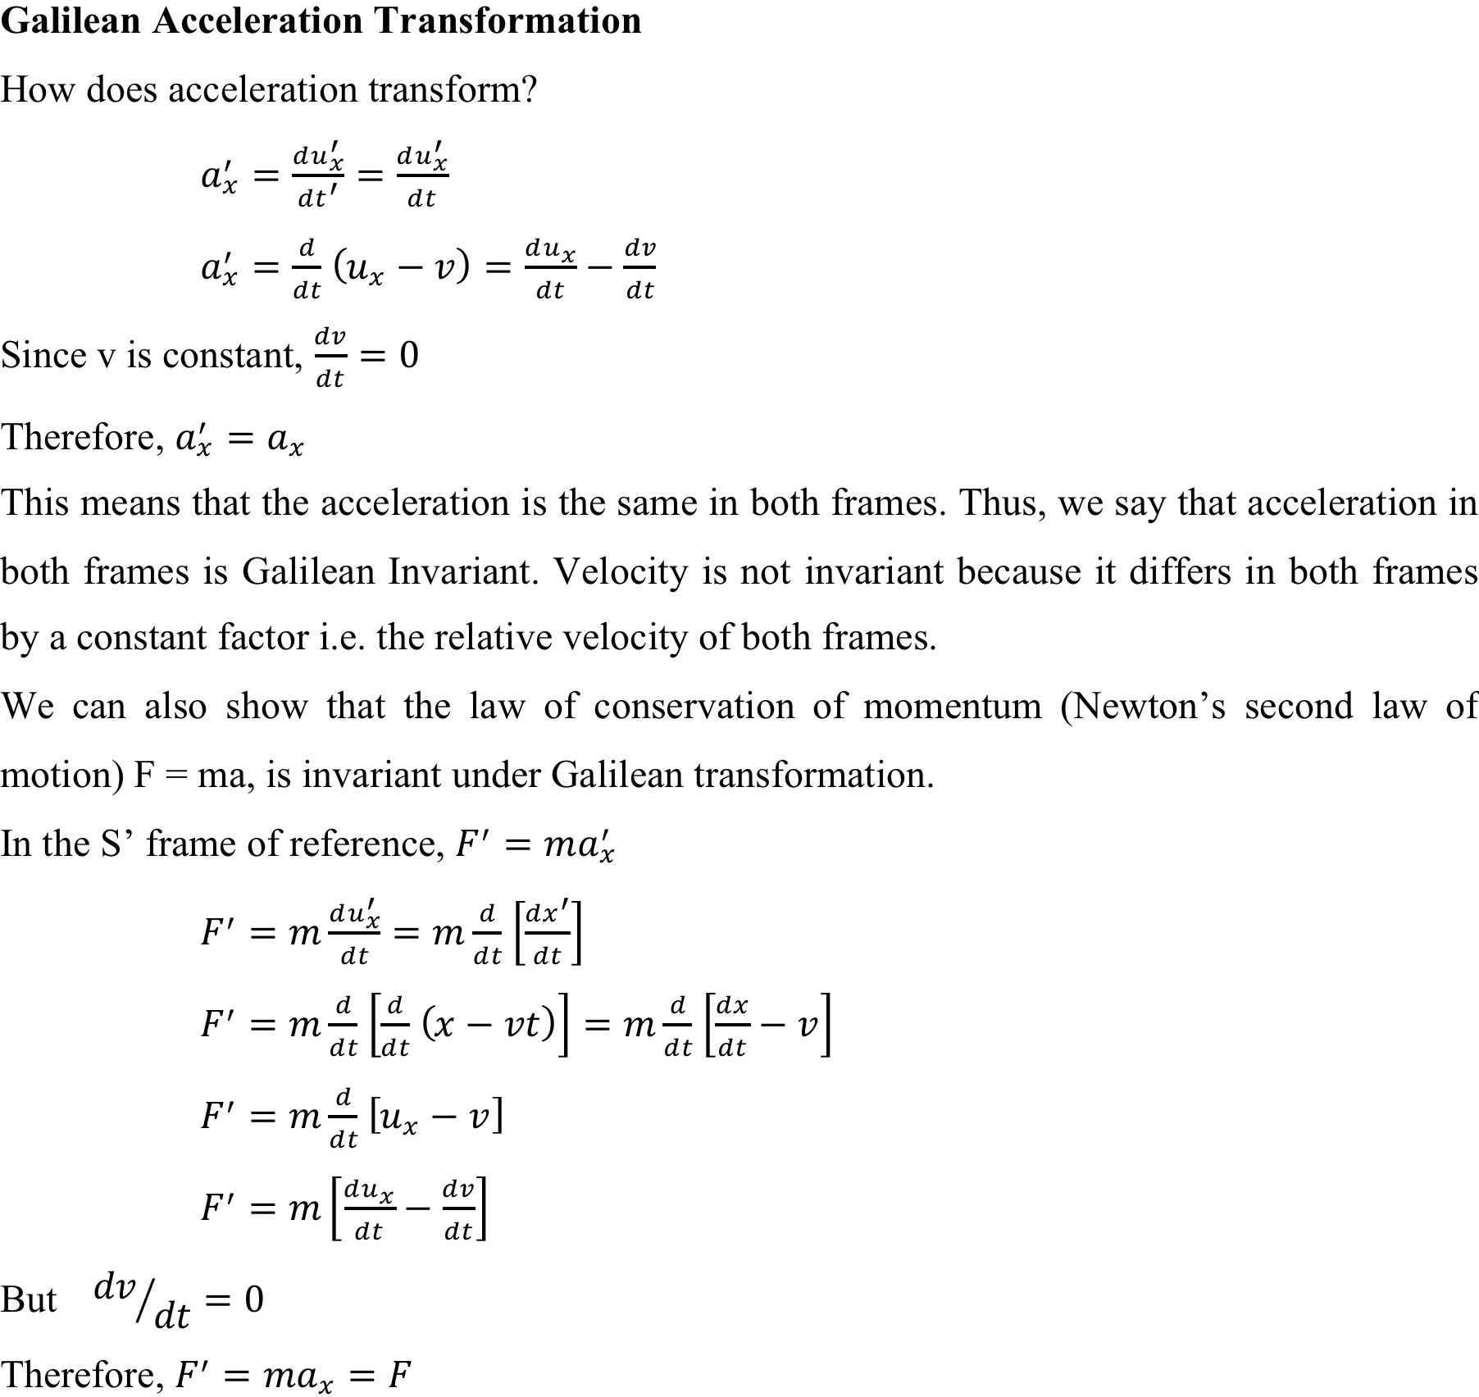

Slide 23
Examples
1: A boat that is initially stationary begins to move with a velocity of 10m/s with respect to x – axis in the positive direction. Let the water on which it moves be reference frame 1 and the boat represents reference frame 2. Assume that reference frame 1 is always stationary and at t = 0 seconds, the two frames coincide. If we are in reference frame 2 and an event takes place by the boat at point (x₂ =50, y₂ =0, z₂ =0) after the boat travelled for 120s, find the equivalent position of this event in reference frame 1.

Slide 24
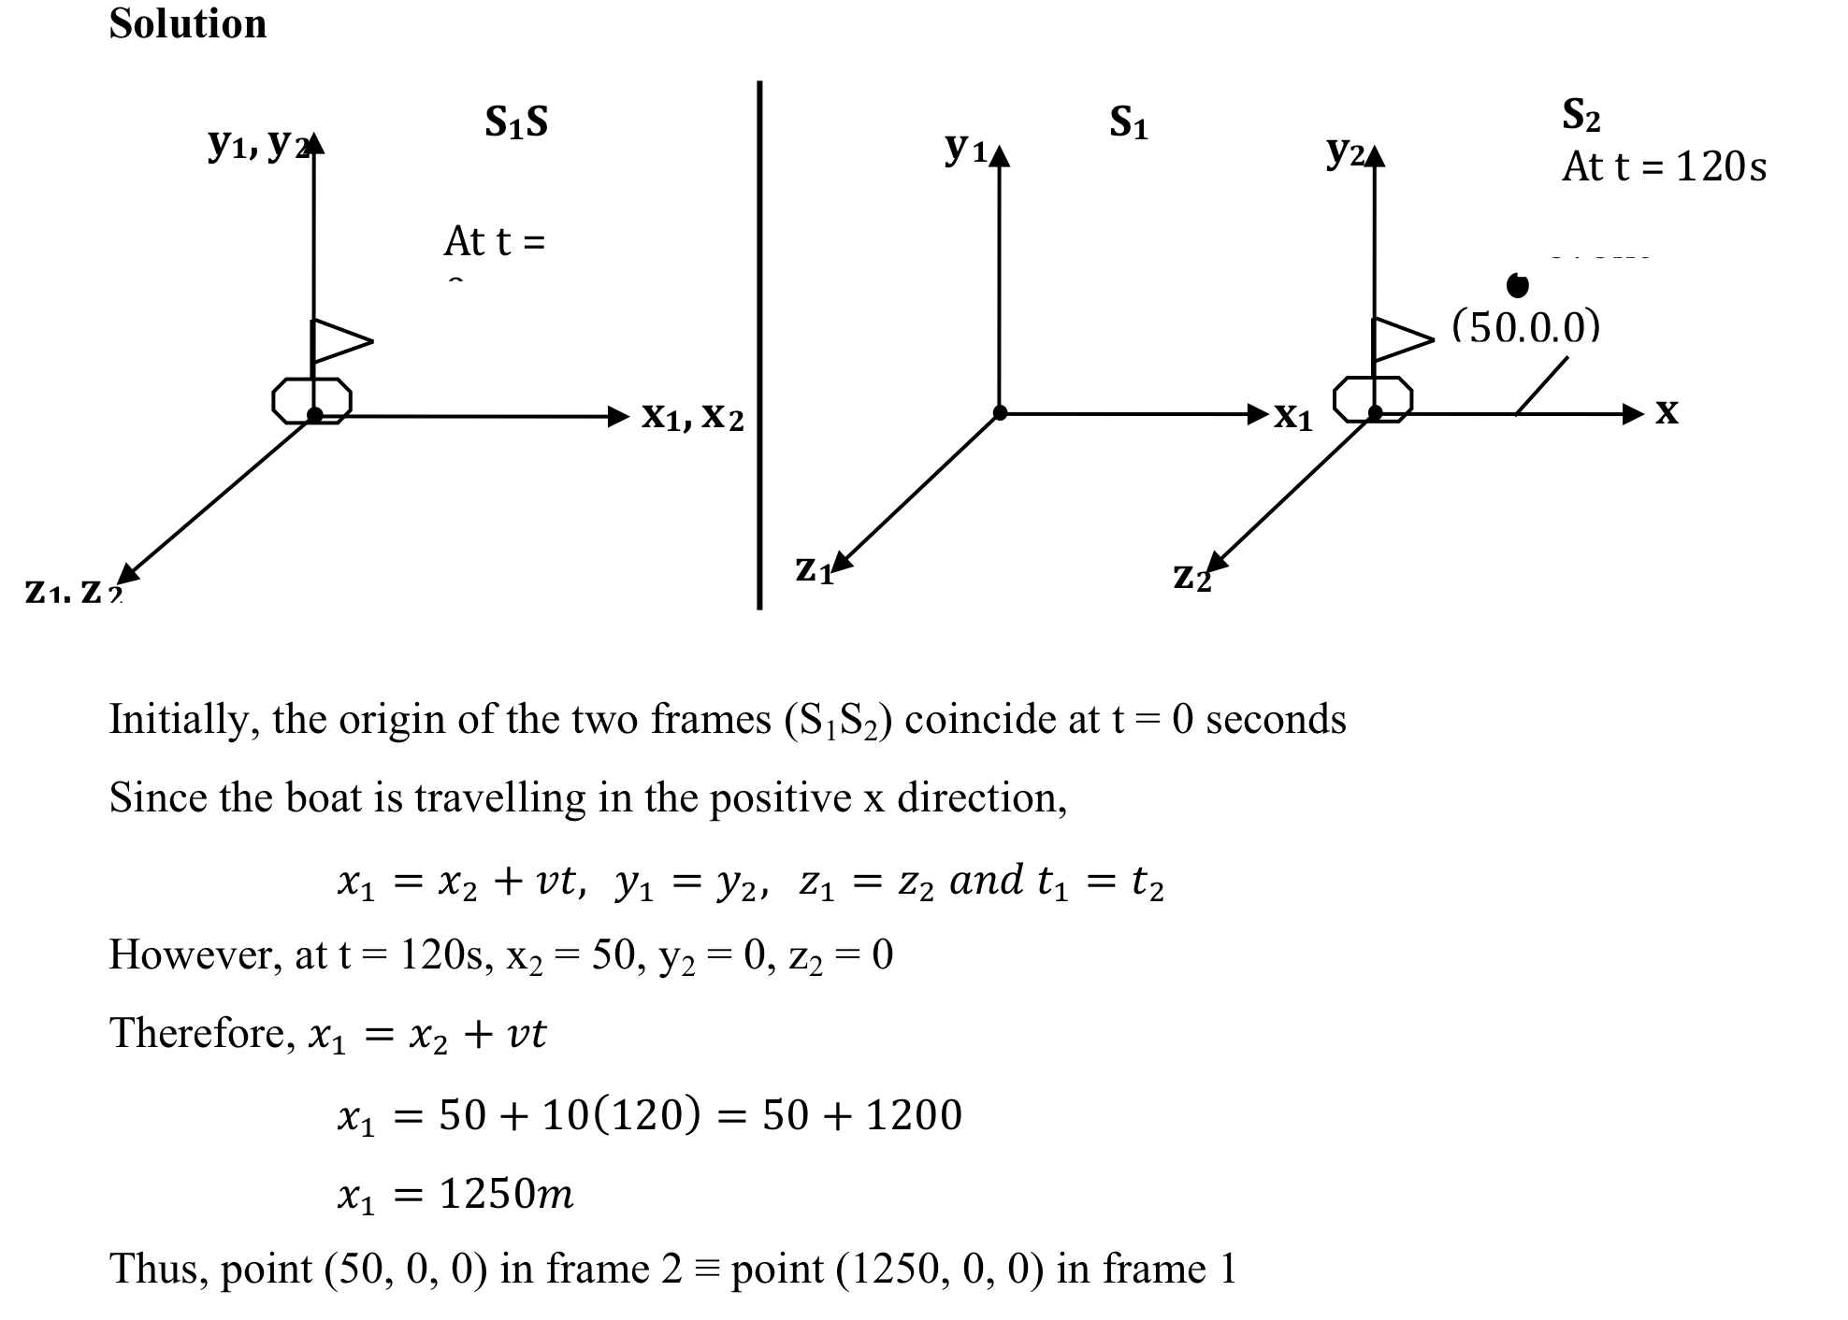

Slide 25
2: At t = 0 seconds, two reference frames consisting of xyz plane coincide such that the origin of one is found at the origin of the second. However, as time progresses, the second reference frame moves in the positive direction along x-axis with velocity of 37m/s, while the first frame of reference remains stationary. At a time of t = 10 seconds, a particle within the second reference frame has a velocity given by vector U'=12, 0, 0 m/s. Find the equivalent velocity U' of the particle with respect to the first reference frame.

Slide 26
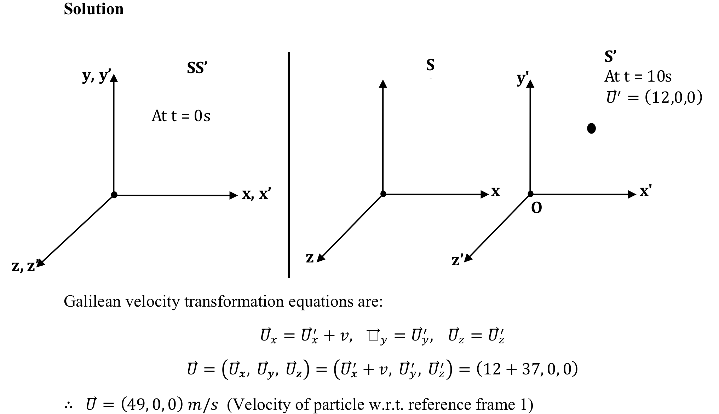

Slide 27
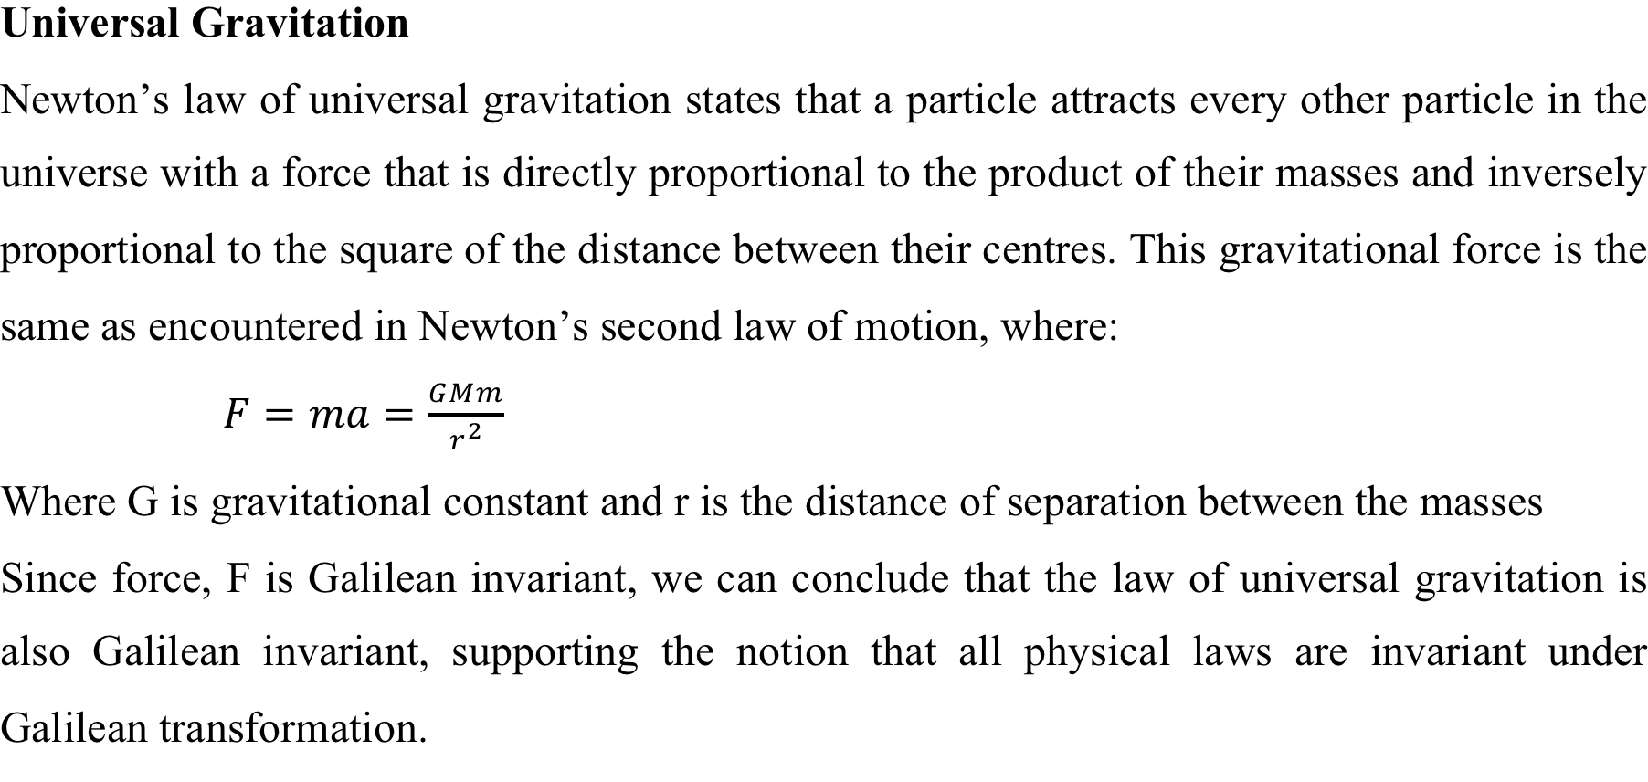

Slide 28
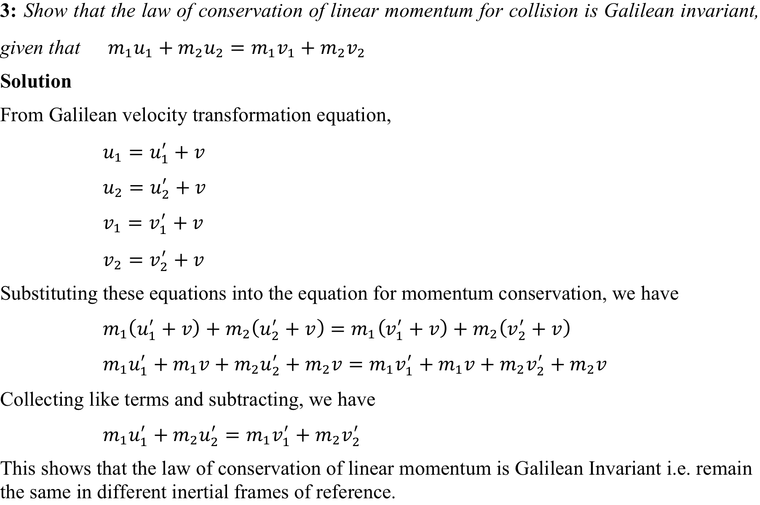

Slide 29
Exercise
7.1 A girl is riding a bicycle along a straight road at constant speed, and passes a friend standing at a bus stop (event 1). At a time of 60s later, the friend catches a bus (event 2). If the distance separating the events is 126m in the frame of the girl on the bicycle, what is the bicycle’s speed? (Ans: 2.10m/s)
7.2 A police car travelling on a straight road at a constant speed of 30m/s catches up with a truck travelling at a constant speed of 20m/s. The police car reaches the truck 25s after it is first sighted. How far ahead of the police car was the truck when it was first sighted? (Ans: 250m)
7.3 Show that the law of conservation of kinetic energy is Galilean Invariant.

Slide 30
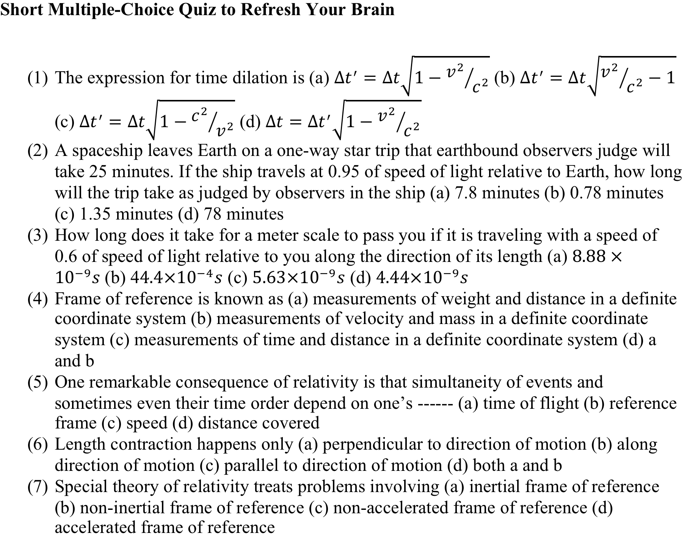

Slide 31
Answer
a
a
d
(4) c
(5) b
(6) b
(7) a

